Slide 1
Digital Portfolio
STUDENT NAME: S.Naveena
REGISTER NO AND NMID: 2428B0234 and
DEPARTMENT: BSc Computer science with Data Analytics
COLLEGE: COLLEGE/ UNIVERSITY: Tiruppur Kumaran College for Women/Bharathiar University
99544C27D3E4ED38E7849C30A73DAE61

Slide 2
PROJECT TITLE
MY DEGITAL PORTFOLIO

Slide 3


AGENDA
Problem Statement
Project Overview
End Users
Tools and Technologies
Portfolio design and Layout
Features and Functionality
Results and Screenshots
Conclusion
Github Link
3/21/2024 Annual Review

Slide 4

PROBLEM STATEMENT
In today’s digital age , writers often struggle to showcase their work in a professional way with more accessibility . Traditional resumes and paper-based portfolios fail to highlight creativity and provide limited reach to potential readers, publishers and clients . There is a need for a simple , user-friendly digital portfolio that allows writers to present their biography, showcase their works(articles , poems, short stories),and provide contact information in an attractive and organized format

Slide 5

PROJECT OVERVIEW
Brief Summary:
My project focuses on creating a simple digital portfolio for writers to present their professional identity online .The design is clean and easy to navigate ensuring that potential readers or clients can quickly access the writer’s work.
Portfolio Contains: The portfolio provides sections such as About Me, My Works and Contact allowing writers to introduce themselves ,showcase selected writings like articles , poems, short stories and share their contact details.
Main Idea:
The portfolio is designed to highlight the writer’s personal achievements, creative works and professional identity in a structured digital format allowing them to effectively present their skills and accomplishments to a wider audience

Slide 6

WHO ARE THE END USERS?
Students:
To Showcase essays or creating writings projects for schools or colleges. Builds an early online presence to prepare for higher studies or competitions and share their achievements.
Job Seekers:
Highlight writings samples relevant to job roles for example :content writing, journalism, copywriting.
Freelancers:
Use the portfolio as a marketing tool to attract clients and showcase different types of work like blogs or social media posts and provide quick contact details so clients can reach out directly .
Professionals:
Build a strong digital identity beyond a traditional CV.

Slide 7

TOOLS AND TECHNIQUES
1.HTML
Used to structuring the content of the portfolio such as About Me, My Works, Achievements and Contents
2.CSS
Applied for styling, layout and visual design to make the portfolio attractive and readable
3.Java Script for Navigation
Internal links ensure smooth movements between different sections of the portfolio
4.Responsive
Basic techniques were used to make the portfolio viewable on desktops and mobile devices
5.Code Editor
CODEPEN

Slide 8
POTFOLIO DESIGN AND LAYOUT
Header Section
Displays the writer’s name and a tagline. Sets the tone and identity of the portfolio
Navigation bar
Provides quick links to sections: About Me, My Works, Contact and helps users to move smoothly within the page
About Me
Contains a short biography or introduction and highlights writing interests and professional background
My Works Section
Showcases selected writings such as articles , poems ,and short stories and organizes card-style layout for clarity
Content Section
Provides email and social media links for easy communication
Responsive layout
Mobile view
8

Slide 9
FEATURES AND FUNCTIONALITY
1.User-friendly Design : Clean and simple layout that is easy to navigate
2.Display Function: Presents the writer’s profile , introduction and personal details
3.Navigate Function : Provides internal links for moving between sections like About, My Works, and Contact
4.Showcase Function: Highlights writing samples (articles, poems, short stories)using card-style layouts
5.Contact Function: Provides email and social media links for direct communication
6.Responsive Function :Ensures the portfolio adapts to different devices (desktops , tablet, mobile)

Slide 10
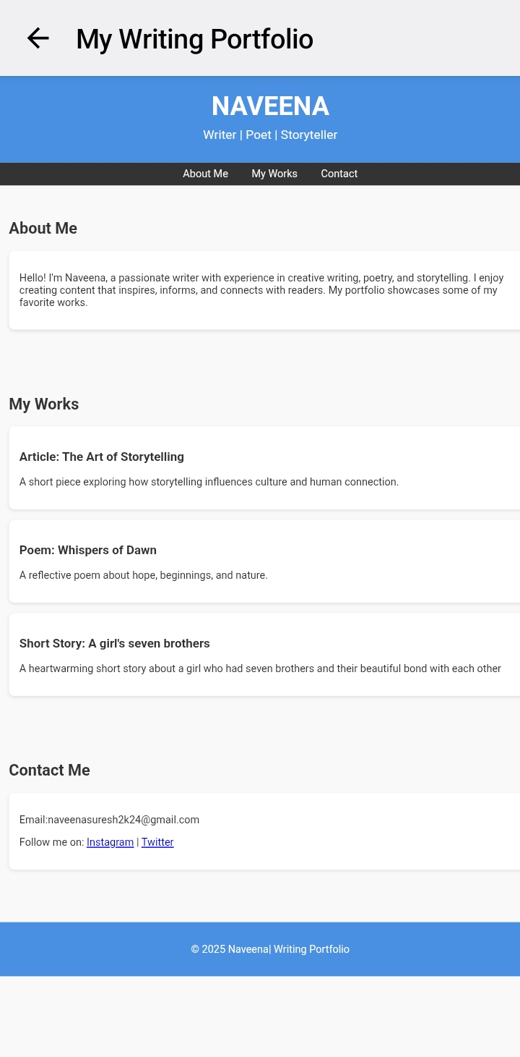

RESULTS AND SCREENSHOTS
3/21/2024 Annual Review
10

Slide 11
CONCLUSION
My Digital Writing portfolio provides a simple and effective way to showcase a writer’s creative works and contact information in one place .Designed with HTML,CSS and Java script it offers a clear layout easy navigation and responsive design .This portfolio helps to build a writer’s professional identity into reaching a wider audience
11

